Slide 1
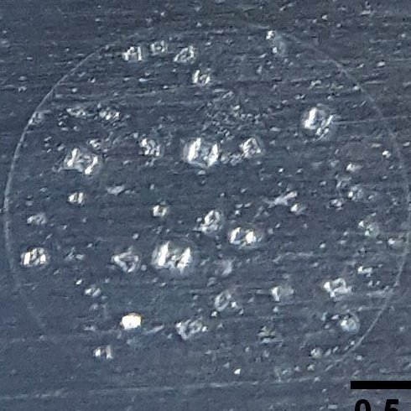
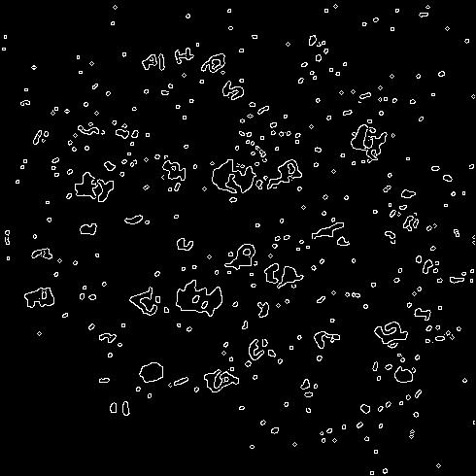
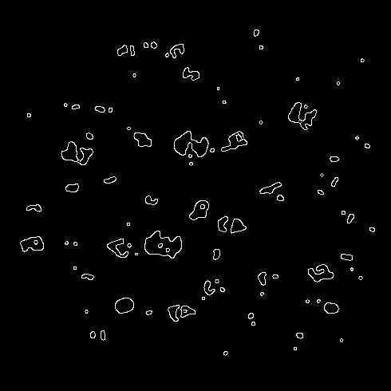
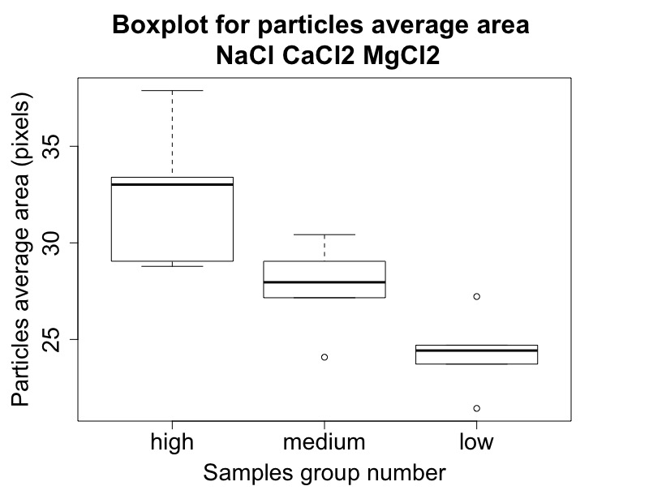
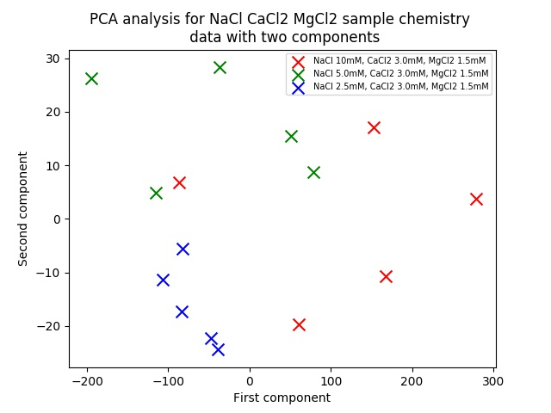
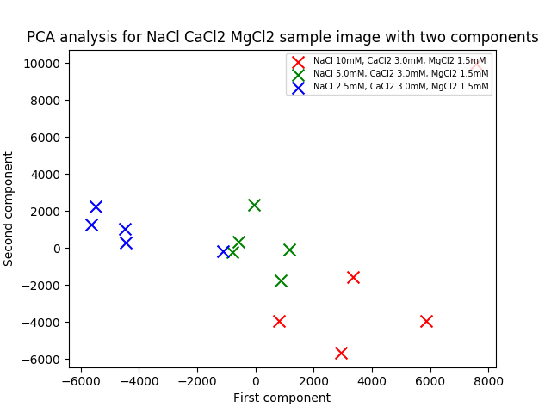
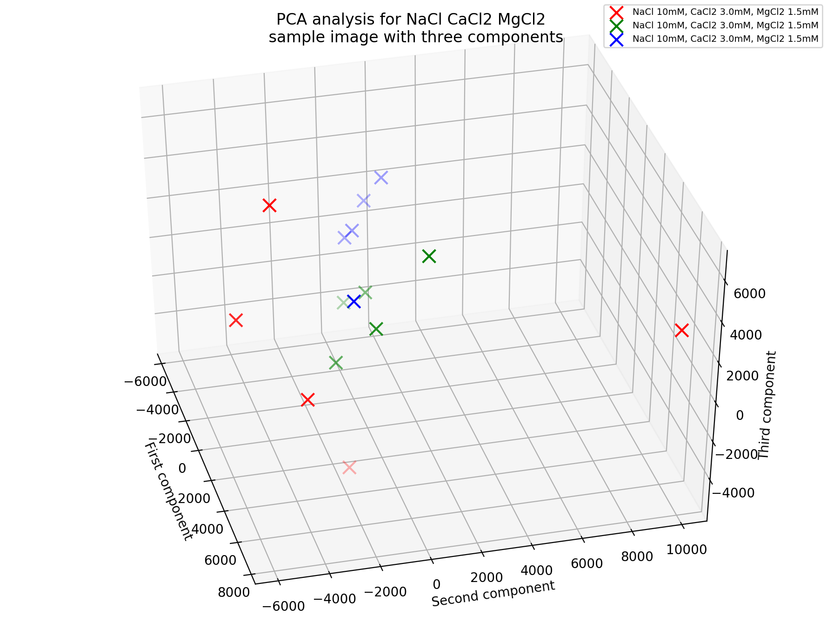
Original RGB images
Matlab im2bw function
Black white images
Matlab medfilt2 function
Noise removed black white images
particles average perimeter
particles average area
particles number
Image information extracted
PCA analysis on python by extracted information
PCA analysis used to test distinguishable between images.
Boxplot plotted by r
boxplot utilized to prove extracted features differences between samples
t-test used to verify significance difference
PCA image analysis on python by image data
PCA analysis with three eigenvectors extracted.
Image converted to grey scale and grouped together. Then use PCA to analysis these images. First 2 eigenvalues selected.2-d projection plotted

